Slide 1


Twitter: @ConEd_TDSB

Slide 2

Continuing Education
Overview
Continuing Education supports student achievement, well being and lifelong learning for 100,000 learners each year, from kindergarten through to seniors.
Programs are delivered in locations across the city during the day, night, weekend and summer.
Collaboration with TDSB departments, schools and community organizations promotes diverse and responsive programming.

Slide 3
Continuing Education
Programs
Adult English as a Second Language
General Interest & Seniors’ Daytime
Credit Night School
Credit Saturday International Languages
Adult High School Credit Daytime
International Languages & African Heritage
Literacy and Numeracy Outside the Day School
Programs for International Adult Students and Educators
Focus on Youth
Summer School

Slide 4

Continuing Education
Adult English As A Second Language (ESL)
Learners improve their skills in English to gain employment, prepare for post-secondary programs and to participate in the community and in their children’s education.
Classes are offered free of charge to residents of Canada and at an hourly fee to visitors.
Classes offered include:
  Conversation
  Language proficiency test preparation
  ESL Literacy
  Family classes, where children are welcome
  Business language and computer skills courses
Teaching English as a Second Language (TESL) Training Program

Slide 5
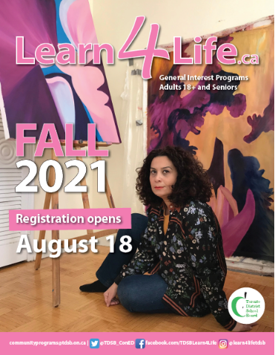


Continuing Education
General Interest and Seniors’ Daytime - Learn4life
Programs provide opportunities for adults to develop skills and interests and to explore paths to health and wellness.
Course categories include:
  Arts
  Business
  Computers
  Cooking
  Dance
  Fitness
  Languages
  Music

Slide 6
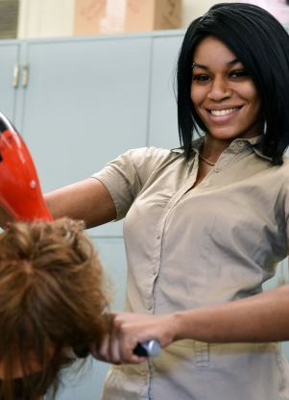
Continuing Education
Adult High School
Five quadmestered adult high schools support adult learners with pathways to support their academic and career goals.
Students complete their Ontario Secondary School Diploma, prepare for college or university, or gain job-related training along with certificates in specialty programs such as PSW, Childcare Assistant, Medical Office Assistant and Hairstyling.
Each school also hosts EdVance, a program specifically for students who are 18-20 year olds and have been out of school or are behind in credit accumulation.
Schools:
  Burnhamthorpe Adult Learning Centre
  City Adult Learning Centre
  Emery Adult Learning Centre
  Scarborough Centre for Alt Studies Adult
  Yorkdale Adult Learning Centre

Slide 7
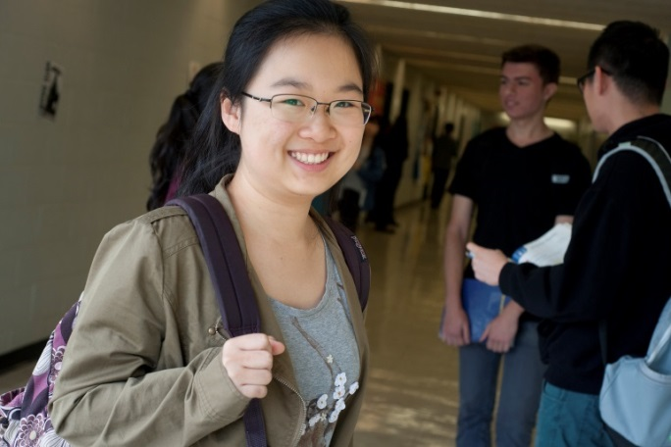
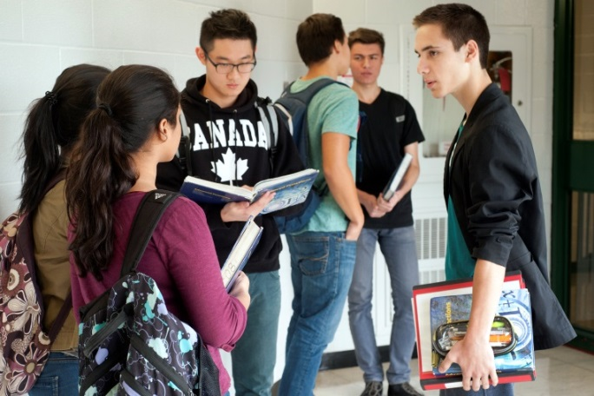
Continuing Education
Credit Night School
High school students benefit from expanded opportunities for credit accumulation and changing pathways.
Course selections are made in accordance with the Ministry of Education curriculum guidelines. Parent/Guardian(s) and students consult with their day school guidance counsellor regarding course selections and pre-requisite courses.
We also offer Saturday International Languages Credit Programs.

Slide 8
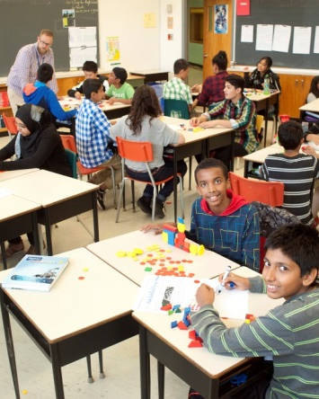
Continuing Education
Literacy and Math Outside the School Day
Students in Grades 7 to 12 during the school year are supported through opportunities to further develop skills in literacy and numeracy and to build confidence.
Ministry guidelines require principal recommendation for students to attend a program.
Classes are taught by qualified teachers and are scheduled outside the school day.

Slide 9
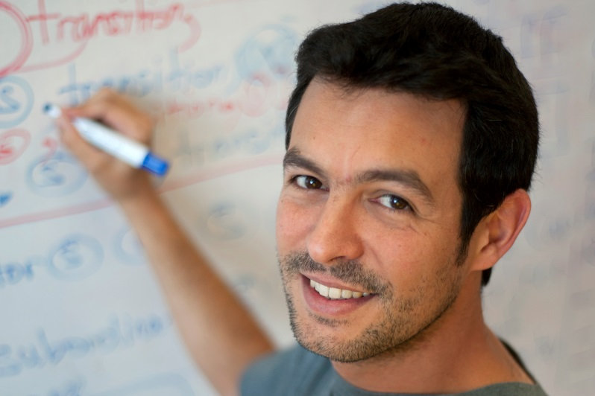
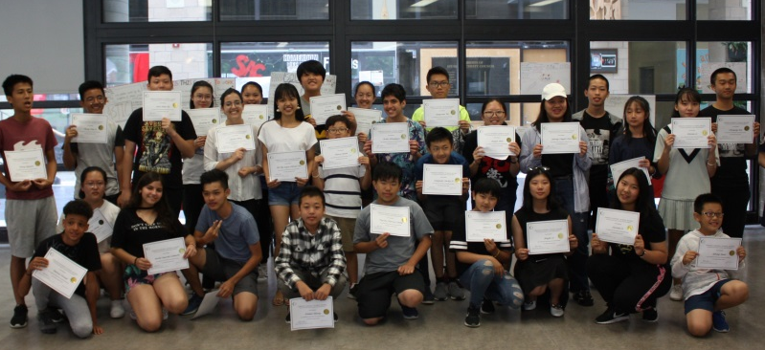
Continuing Education
Programs For International Adult Students And Educators
International adult learners are recruited to attend one of our 5 Adult High Schools.
Through the Academic Pathway Program, students earn credits, meet post-secondary pre-requisites, and earn coop certificates.
International Educators are offered professional learning opportunities through programs created for their specific interests.

Slide 10
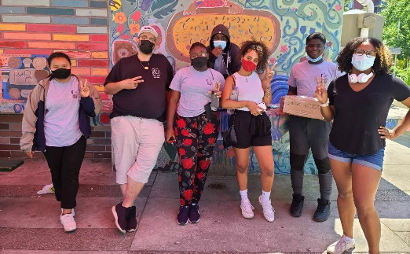
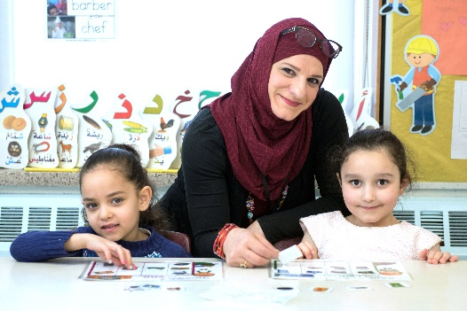
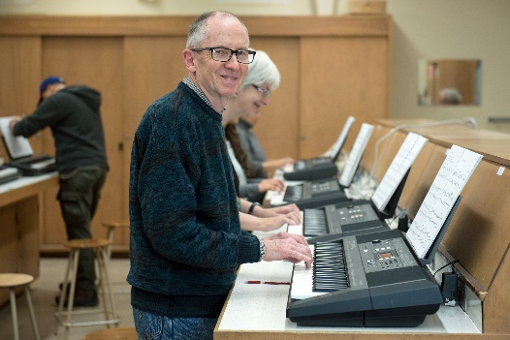
Continuing Education
Summer Programs
Learners of all ages participate in Continuing Education summer learning opportunities.
Programs include:
  Elementary literacy and numeracy
  Head Start to High School- Grade 8 transition to high school
  Elementary International Languages and African Heritage
  Elementary Music and Arts Camp
  International Summer Camp – ages 12 to 17
  Secondary Credit
  Focus on Youth
  Adult English as a Second Language
  Adult High School Credit
  General Interest Programs
  Parent/Guardian Programs
Continuing Education collaborates with CEBSA, UIEC, Early Years, Model Schools, Special Education, Outdoor Education and Leadership, Learning and School Improvement.

Slide 11
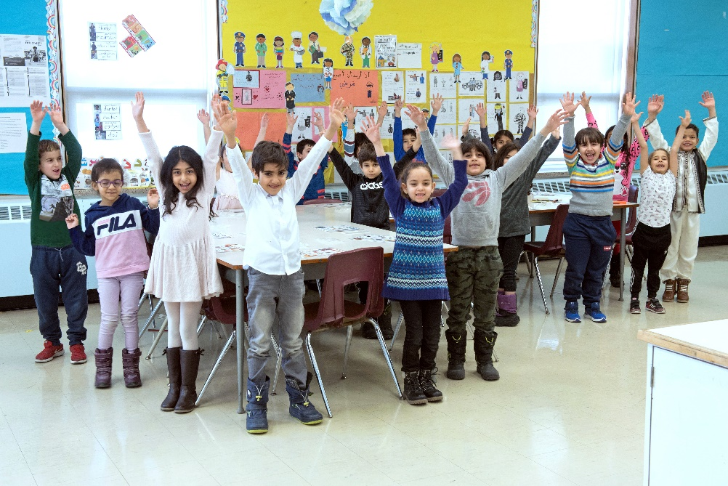
Continuing Education
International Languages and African Heritage
Students from Grades K to 8 participate in programs offered after school, evenings and on weekends.
Programs combine language and culture learning with engaging activities.
Over 50 languages are offered.
Top 5 languages:
  Mandarin Simplified
  Tamil
  Spanish
  Arabic
  Cantonese

Slide 12
Continuing Education
Questions?
Thank you for your time

